Slide 1
Bacteria
α-diversity
Hetero-trophic nano-flagellate (HNF)
α-diversity
Deterministic
assembly processes of
bacteria community
Deterministic
assembly processes of
HNF community
Deterministic
assembly processes
of HNF (Bacteria) community
HNF (Bacteria) diversity
Bacteria (HNF) diversity
Deterministic assembly processes
of HNF (Bacteria) community

Slide 2
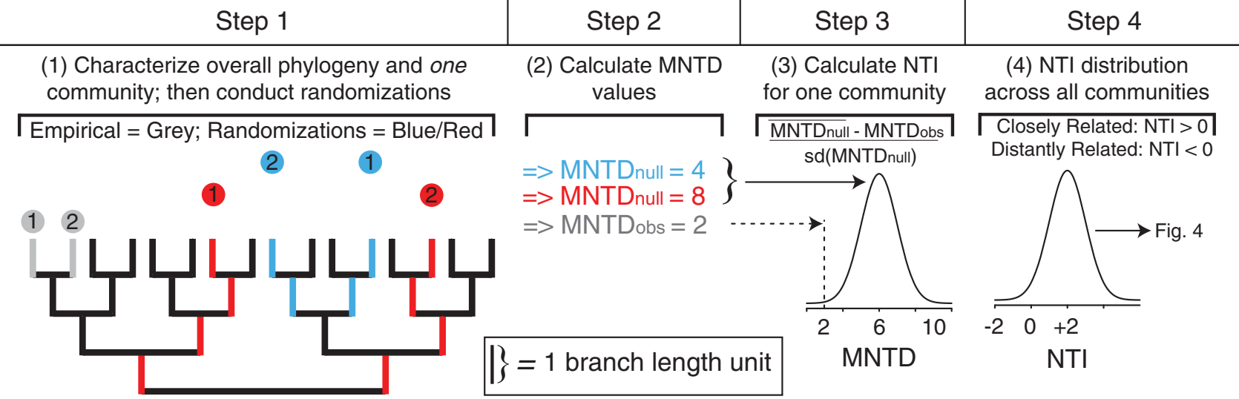
α level assembly processes

Slide 3
Positive αNTI : divergent selection
Negative αNTI : homogeneous selection
αNTI
MNTD_{obs}
Null mean
MNTD

Slide 4
Dispersal force
Inferred from community dissimilarity
Positive : divergent dispersal
Negative : homogeneous dispersal
Dispersal force
Chao_{obs}
Null mean
Community dissimilarity (Chao’s β diversity)

Slide 9
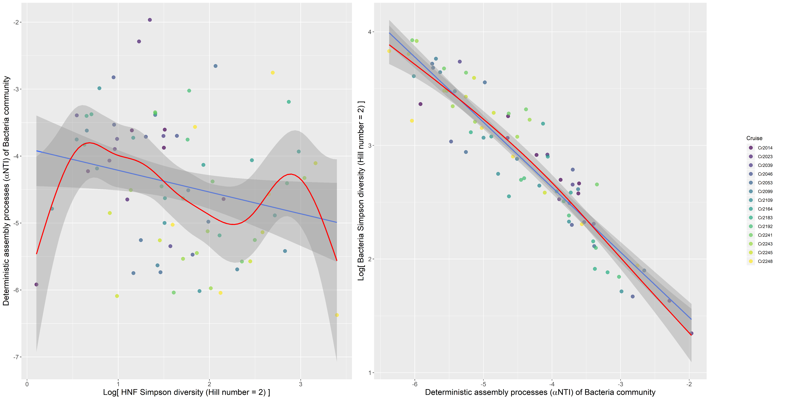

Slide 10
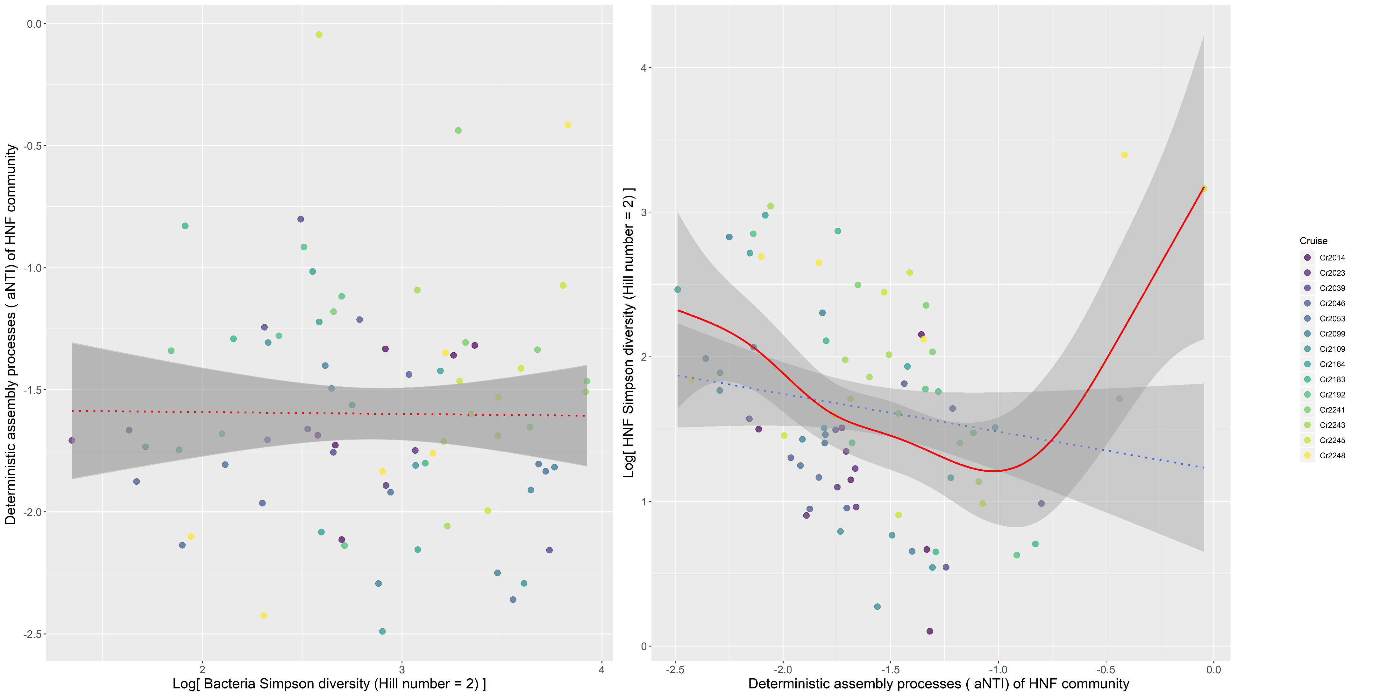

Slide 11
Bacteria Simpson diversity
(Hill number = 2)
HNF Simpson diversity
(Hill number = 2)
-0.33
-0.57
0.25
Dispersal force on
Bacteria community
Deterministic assembly processes (βNTI) of
Bacteria community
Deterministic assembly processes (βNTI) of
HNF community
Dispersal force on
HNF community

Slide 12
Bacteria biomass
HNF biomass
Bacteria Simpson diversity
(Hill number = 2)
0.03 (p = 0.09)
HNF Simpson diversity
(Hill number = 2)
-0.33
-0.56
0.23
Dispersal force on
Bacteria community
Deterministic assembly processes (βNTI) of
Bacteria community
Deterministic assembly processes (βNTI) of
HNF community
Dispersal force on
HNF community

Slide 13
Bacteria biomass
HNF biomass
Bacteria Simpson diversity
(Hill number = 2)
0.03 (p = 0.09)
HNF Simpson diversity
(Hill number = 2)
-0.33
-0.56
0.23
Dispersal force on
Bacteria community
Deterministic assembly processes (βNTI) of
Bacteria community
Deterministic assembly processes (βNTI) of
HNF community
Dispersal force on
HNF community
Bacteria community is more subjected to deterministic assembly processes

Slide 14
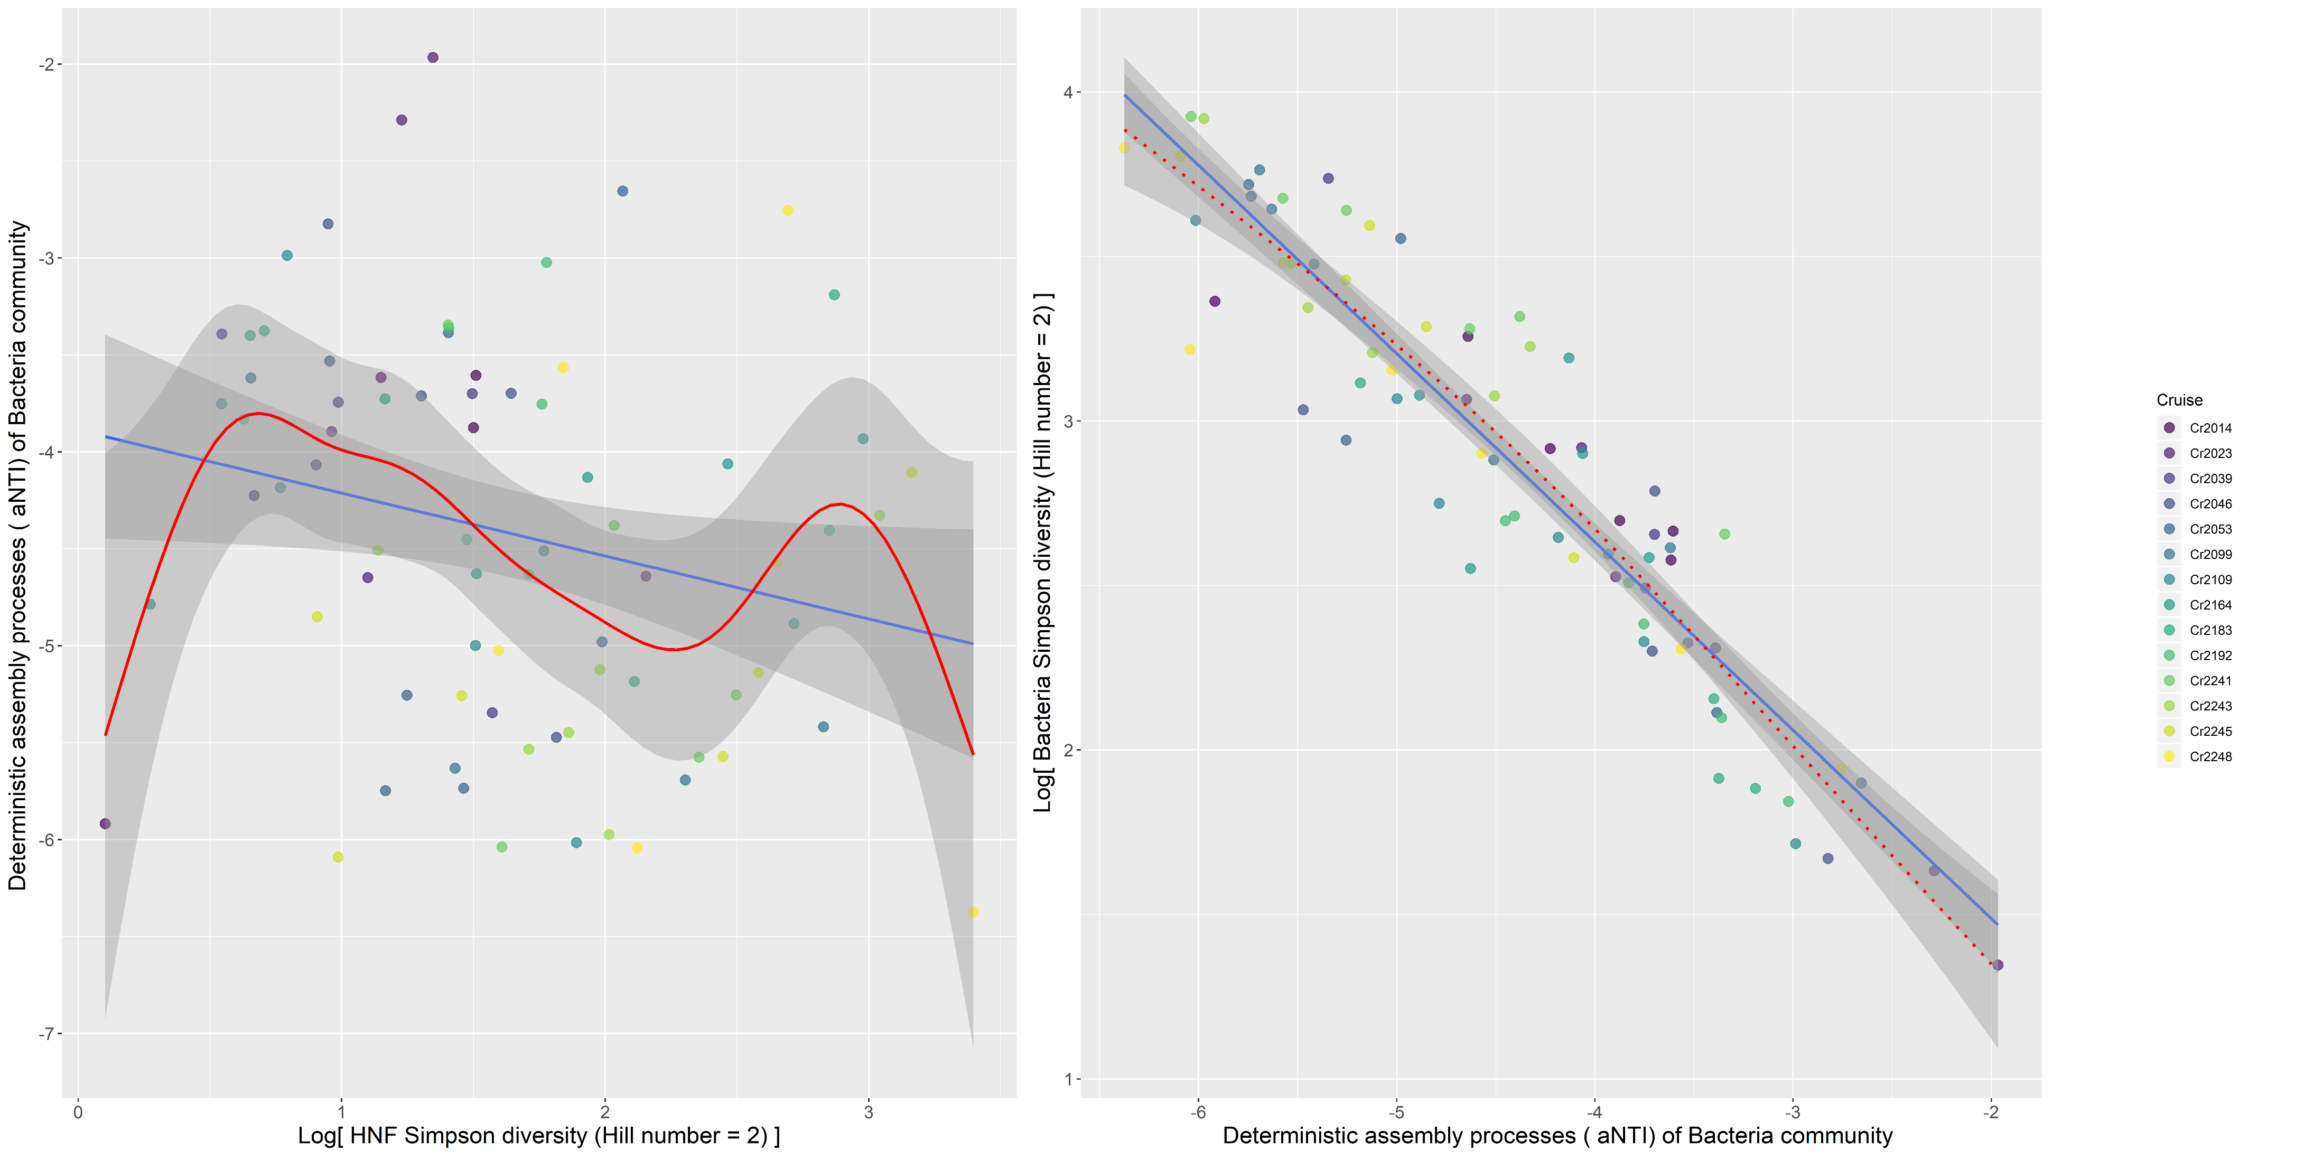
HNF Simpson diversity decreases homogeneous selection on bacteria community, which then decreases bacteria Simpson diversity

Slide 15
Bacteria biomass
HNF biomass
Bacteria Simpson diversity
(Hill number = 2)
0.03 (p = 0.09)
HNF Simpson diversity
(Hill number = 2)
-0.33
-0.56
0.23
Dispersal force on
Bacteria community
Deterministic assembly processes (βNTI) of
Bacteria community
Deterministic assembly processes (βNTI) of
HNF community
Dispersal force on
HNF community
HNF community is subjected to stochastic dispersal force

Slide 18
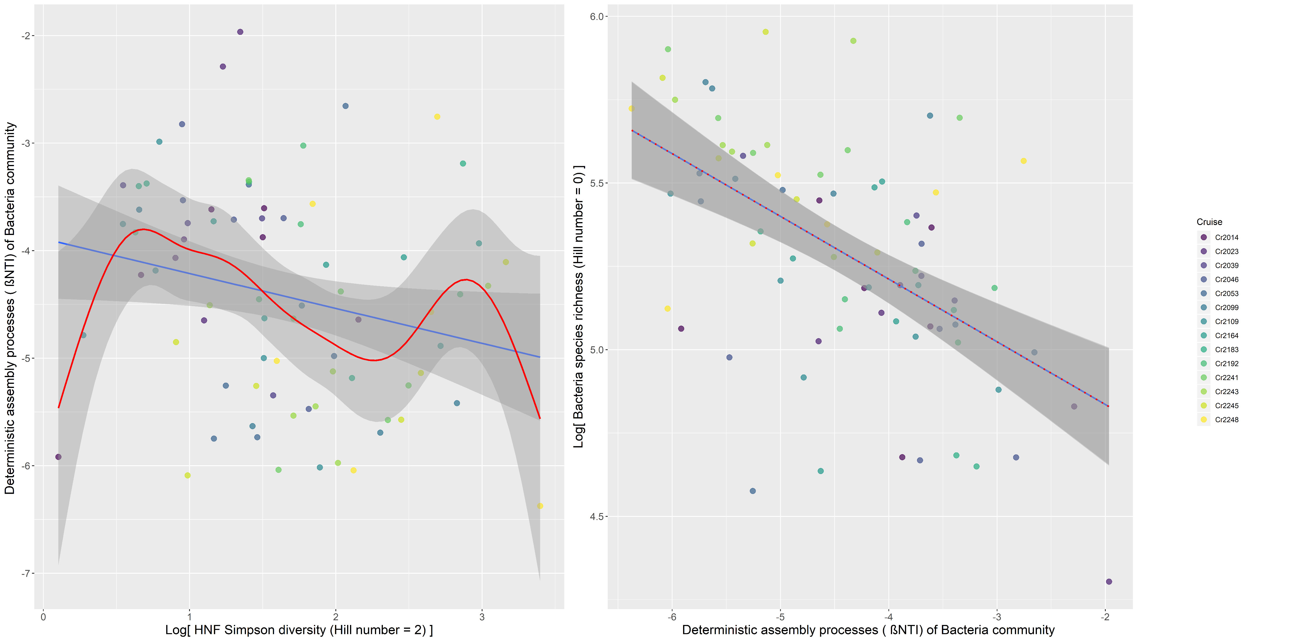

Slide 19
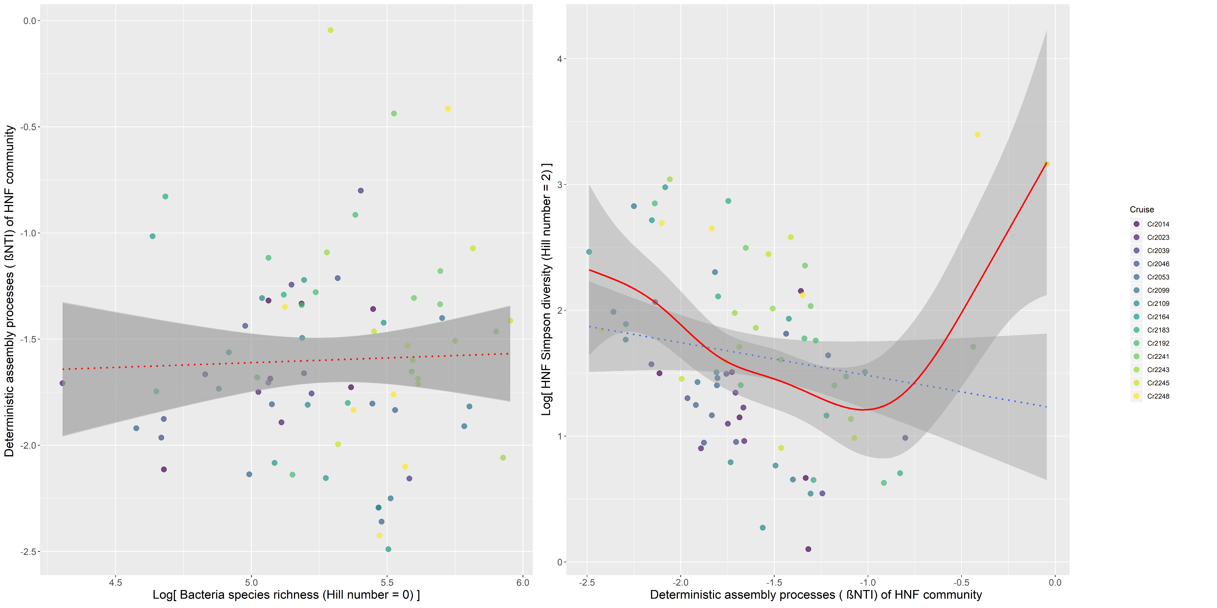

Slide 20
Bacteria species richness
(Hill number = 0)
0.06
HNF Simpson diversity
(Hill number = 2)
-0.33
-0.29
(p = 0.09)
-0.17
Dispersal force on
Bacteria community
Deterministic assembly processes (βNTI) of
Bacteria community
Deterministic assembly processes (βNTI) of
HNF community
Dispersal force on
HNF community

Slide 21
Bacteria biomass
HNF biomass
-0.55 (p = 0.09)
Bacteria species richness
(Hill number = 0)
0.06
HNF Simpson diversity
(Hill number = 2)
-0.33
-0.29
(p = 0.09)
-0.17
Dispersal force on
Bacteria community
Deterministic assembly processes (βNTI) of
Bacteria community
Deterministic assembly processes (βNTI) of
HNF community
Dispersal force on
HNF community

